Slide 1

This course was developed as a part of the VLIR-UOS Cross-Cutting projects:
Statistics: 2011-2016, 2017.
Statistics: 2017.
Statistics for development : 2018-2022.

Slide 2





Introduction to Statistical inference and estimation using R: Inference for categorical data
The >eR-Biostat initiative
Making R based education materials in statistics accessible for all
Developed by
Ziv Shkedy (Hasselt Univesrsity) and Tadesse Awoke (Gondar University)
ER-BioStat
https://github.com/eR-Biostat
Email: erbiostat@gmail.com
@erbiostat

Slide 3
Development team
Tadele Worku Mengesha (Gondar University).
Abdisa Gurmessa (Jmma University).
Ziv Shkedy (Hasselt Univesrsity).
Tadesse Awoke (Gondar University).
Adetayo Kasim (Durham University).

Slide 4

Recommended reading
We cover mainly Chapter 8 (Section 8.1-8.3).
The examples that are used for illustration are not the same as the examples in the book.
Chapter 8: Inference for categorical data

Slide 5
Software
R functions:
  prop.test().
  chisq.test().

Slide 6
YouTube tutorials
YouTube tutorials are available for:
  Inference on a Proportion in R... using prop.test() (host: Ed Boone): https://www.youtube.com/watch?v=-msRQ0YZtAY.
  Confidence intervals on proportions in R (host: Ed Boone): https://www.youtube.com/watch?v=l-n8PAnEbN0&t=57s.

Slide 7
Datasets
Data are given as a part of R programs for the course.
External datasets (which are not given as a part of the R code) and used for illustration are available online.

Slide 8
Topics
Inference for a single proportion.
Confidence intervals for a single proportion.
Inference for two independent samples.
Chi-squared test for independence.

Slide 9
Inference for a single proportion
Section 8.1

Slide 10
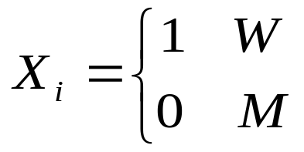
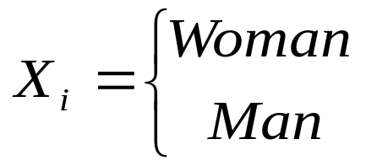
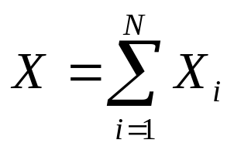
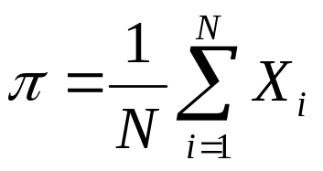
Population
Population: random variable with two categories.
Example: in the Belgian population
What is the number of women in Belgium?
What is the proportion of women in Belgium?

Slide 11
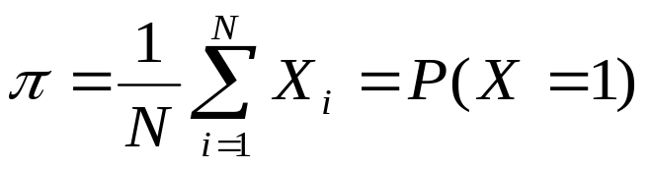
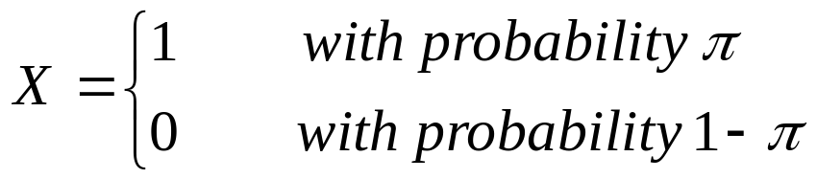
The population: Bernoulli distribution
Thus, the unknown parameter of the population is :
We say that X is a Bernoulli distribution with parameter π follows:

Slide 12
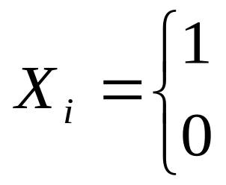
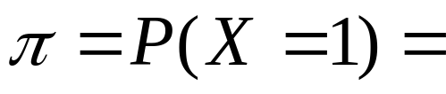
Example
HairEyeColor data were used to show the proportion of the gender. Suppose X is the sex.
Female
  Male
P(Female)
→ We want to estimate π

Slide 13
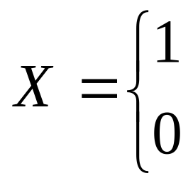
Sample from the population
where:
  1: female
  2: male
sex | Frequency | Percent | Cumulative Frequency | Cumulative Percent
1 | 313 | 52.872 | 313 | 52.872
2 | 279 | 47.128 | 592 | 100.00
Thus
When sex is female
  When sex is male
sex | Frequency | Percent | Cumulative Frequency | Cumulative Percent
1 | 313 | 52.872 | 313 | 52.872
0 | 279 | 47.128 | 592 | 100.00

Slide 14
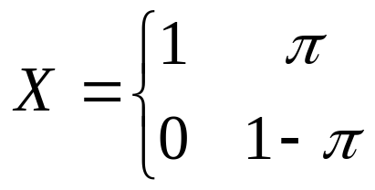
Bernoulli distribution
Population mean and population variance :
When sex is female
  When sex is male
Unknown parameter

Slide 15
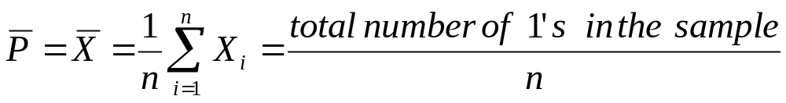

The sample mean
A sample is, as always, a row of random measurements X1, ..., Xn are independent and have the same distribution as X.
The sample mean is:
The sample proportion (notation ).
Point Estimator of π

Slide 16
Frequency Table of “gender”
When sex is female
The sample proportion is a point estimator for the unknown proportion of the population in our example:
52.872% of the sample were females.
  When sex is male
spine | Frequency | Percent | Cumulative Frequency | Cumulative Percent
1 | 313 | 52.872 | 313 | 52.872
0 | 279 | 47.128 | 592 | 100.00

Slide 17
Point estimate of population proportion using R
> malefemale=apply(HairEyeColor,3,sum)
> n=sum(malefemale)
> pbar=malefemale[2]/n
> Pbar
Female
0.5287162

Slide 18
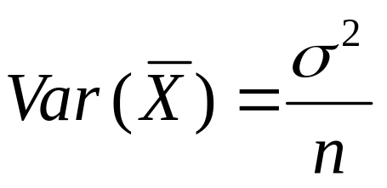
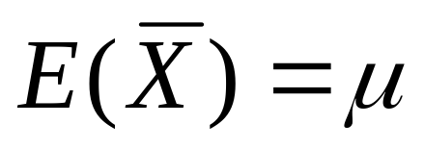
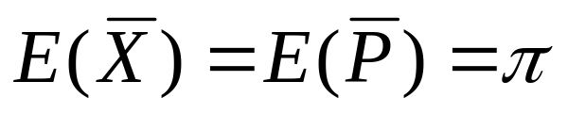
Point Estimator for population mean
As it is generally true that
i.e. an unbiased estimator for π

Slide 19
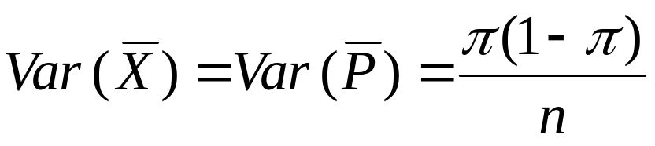
Variance of
As it is generally true that

Slide 20
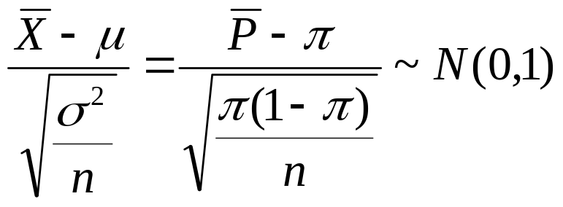

Central limit theorem
From former properties of the sample mean we get in particular for that for n large
Since π in most cases is not known, we replace, if necessary π (1 - π) by

Slide 21
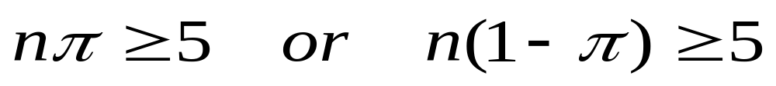
What does the sample size(n) large?
Our previous condition for such an approach was: n ≥ 30.
Although in most cases turns out well, there is a rule of thumb that is more specific for proportions.
This says that the approach is good if both true:

Slide 22
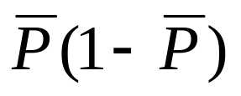
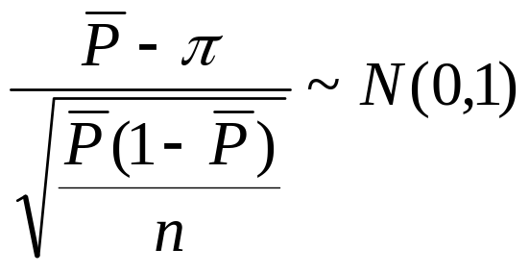
In the normal approximation, we replace the unknown π (1-π) by
This gives

Slide 23
Interval Estimation for population proportions

Slide 24
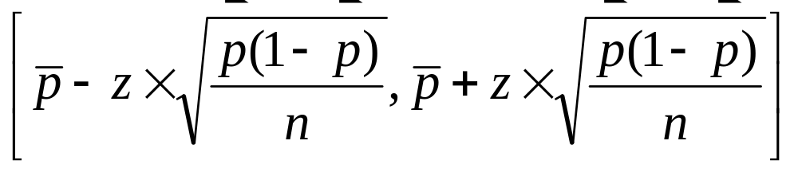
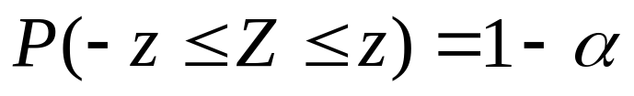
Confidence interval
The (1 - α) x 100% confidence interval for the population proportion
with Z~N(0,1)

Slide 25
Example
Determine a 95% C.I. for the proportion of female in the population
Step 1: choose a confidence level 1-α = 0.95
Step 2: decision on the basis of the data in which case you are :
no normal distribution and unknown σ² but large sample size
(592 x 0.5287 >> 5 and 592 x (1-0.52872) >> 5)
→ case 2, thus normal distribution

Slide 26
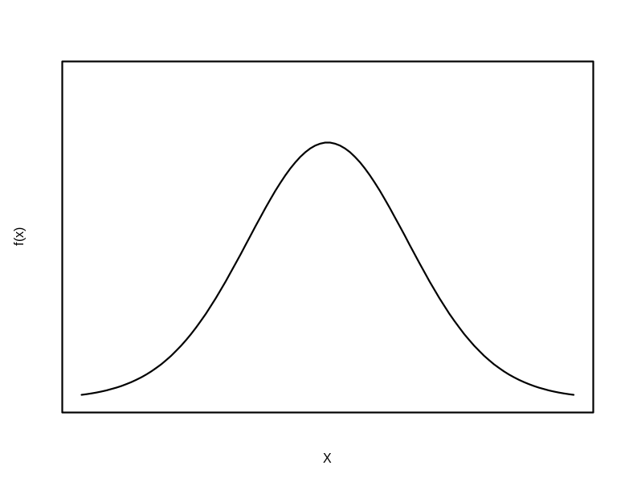

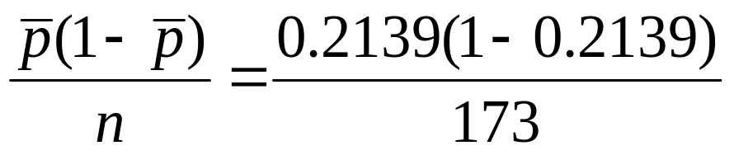
Example: 95% C.I for the population proportion
Step 3: Find the critical points in the correct table: -1.96 and 1.96.
When sex is female
  When the sex is male
N(0,1)
sex | Frequency | Percent | Cumulative Frequency | Cumulative Percent
1 | 313 | 52.872 | 313 | 52.872
0 | 279 | 47.128 | 592 | 100.00
Step 4: calculate the point estimators for μ and σ ²
-1.96
1.96

Slide 27
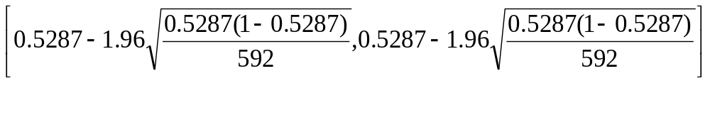


Step 5: calculate the confidence interval :

Slide 28
Example
Decision:
The 95% CI for the proportion of females in the population, is [0.4885,0.5689]
interpretation:
We are 95% confident that between 48.85% and 56.89% of the population are females.

Slide 29
Confidence interval for population proportion using R
> malefemale=apply(HairEyeColor,3,sum)
> n=sum(malefemale)
> pbar=malefemale[2]/n
> SE=sqrt(pbar*(1-pbar)/n)
> E=qnorm(0.975)*SE
> pbar+c(-E,E)
Female Female
0.4885057 0.5689267
OR
> library(TeachingDemos)
> malefemale=apply(HairEyeColor,3,sum)
> prop.test(malefemale[2], sum(malefemale), correct=F)

Slide 30
Hypothesis testing for a proportion

Slide 31

accounts of students in Belgium
example 1
According to "World web stat" there are 10,431,477
resident in Belgium (2011), 77.8% are Internet users and 4,444,500 have FACEBOOK account (42.60% in December 2011) (http://www.internetworldstats.com/stats4.htm#europe)
A researcher wants the proportion of students in Belgium with FACEBOOK account estimating and testing the hypotheses that more than 40% of the students have FACEBOOK account.

Slide 32
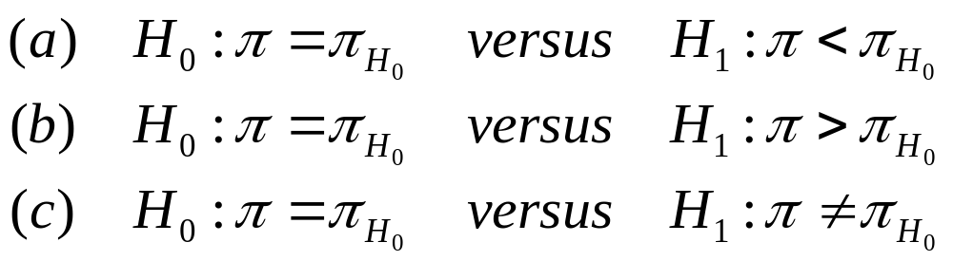
A hypothesis about a population proportion
The general principles on keys remain here valid.
Typical test problems :
π_{H0} which is the value of the population proportion if H₀ is true.

Slide 33
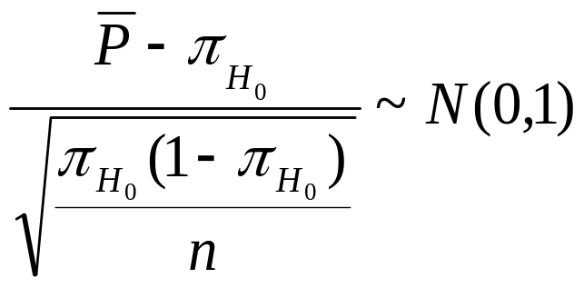
The distribution of the sample proportion
For large samples, we use the property that, if H₀ is true,

Slide 34
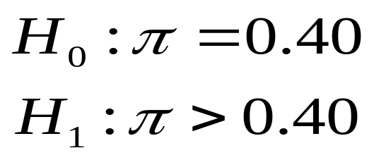
accounts of students in Belgium
example 1
According to "World web stat" there are 10,431,477
resident in Belgium (2011), 77.8% are Internet users and 4,444,500 have FACEBOOK account (42.60% in December 2011) (http://www.internetworldstats.com/stats4.htm#europe
A researcher wants the proportion of students in Belgium with FACEBOOK account estimating and testing the hypotheses that more than 40% of the students have FACEBOOK account.

Slide 35
The sample
The researcher draws a sample of 100 students (Internet users) in Belgium.
In one sample, 47 students have a Face book account.
On the basis of this sample, we can reject the null hypothesis that the proportion of students in Belgium with face book account is 40%?

Slide 36
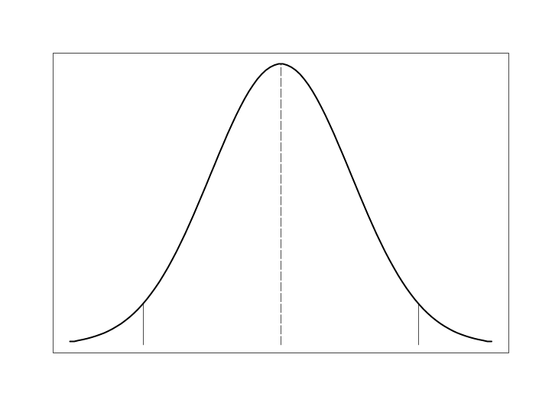
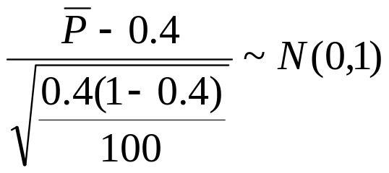
Example: the rejection region
For a significance level α = 0.05 is the rejection region given by
N(0,1)
As 100 x 0.4> 5 x 0.6 and 100> 5, we use that
acceptance regio
rejection region
1.645

Slide 37
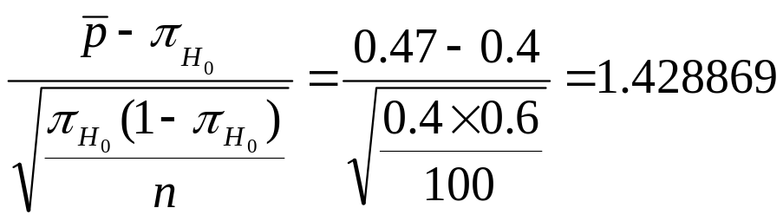
example
The observed value of the statistic is
For a significance level α = 0.05: 1.4288 <1.645.
Conclusion?

Slide 38
R code
> pbar = 0.47
> prop = 0.4
> n = 100
> z=(pbar-prop)/sqrt((prop*(1-prop))/n)
> z
[1] 1.428869
> alpha=0.05
> crit.point=qnorm(1-alpha)#p=0.05 one tailed (upper)
> crit.point
[1] 1.644854
Test statistic
Critical point

Slide 39
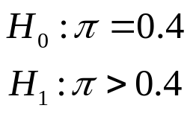

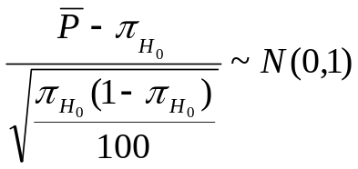
The checklist
Stap | Information | example
1 | The hypotheses (the testing problem)
2 | The level of significance
3 | The test statistic
4 | The distribution of the test statistic under H₀
5 | The critical point (or points)
One-sided test
1.645 N(0,1)

Slide 40
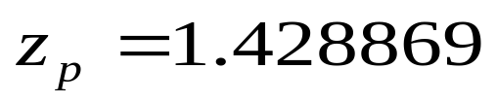
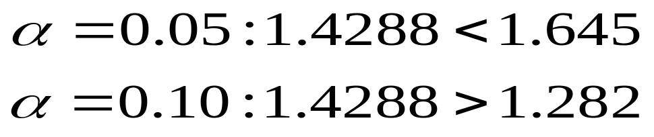
Example: the rejection region
α=0.05 , z=1.645
α=0.1 , z=1.282
N(0,1)
1.282
1.645
rejection region
rejection region
z=1.4288

Slide 41
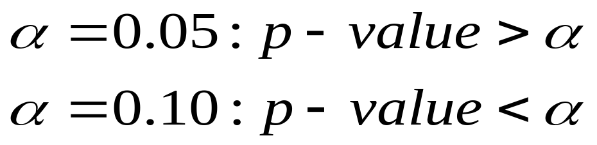
EXAMPLE: p-value
The answer expressed with a p-value is as follows:

Slide 42
R code
> pbar = 0.47
> prop = 0.4
> n = 100
> z=(pbar-prop)/sqrt((prop*(1-prop))/n)
> z
[1] 1.428869
> alpha=0.1
> crit.point1=qnorm(1-alpha)#p=0.1 one tailed (upper)
> crit.point1
[1] 1.281552
> pval = 1-pnorm(z, lower.tail=TRUE) # upper tail
> pval
[1] 0.07652094

Slide 43
Example 2: two-tailed test
In a sample of 1000 women from the aged 50 to 54 whose mother had breast cancer, 40 were found with breast cancer.
Suppose that the overall prevalence rate for breast cancer in women of that age (regardless of their family history) 2%.

Slide 44
The checklist
Step | information | example
1 | The hypotheses (the qualifying problem)
2 | The level of significance
3 | The test statistic
4 | The distribution of the test statistic under H₀
5 | The critical point (or points)
two-tailed test

Slide 45
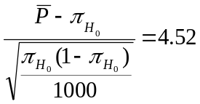
Example: the rejection region
Since 4.52 in the rejection region is (4.52> 1.96), we reject the null hypothesis at 5% significance level.
rejection region
to rejection region
rejection region
-1.96
1.96
4.52

Slide 46
EXAMPLE: p-value
The answer expressed with a p-value is as follows:
The result is (very) significant.

Slide 47
R code
> pbar1 = 0.04 # sample proportion
> prop1 = 0.02 # hypothesized value
> n = 1000 # sample size
> z1=(pbar1-prop1)/sqrt((prop1*(1-prop1))/n)
> z1 # test statistic
[1] 4.51754
> pval = 2*pnorm(z1, lower.tail=FALSE)
> pval
[1] 6.256236e-06

Slide 48
Example
the number of hours of sleep for each of 24 students in class.
if the student got at least 9 hours of sleep(yes).
>sleep=c(7.75,8.5,8,6,8,6.33,8.17,7.75,7,6.5,8.75,8,7.5,3,6.25,8.5,9,6.5,9,9.5,9,8,8,9.5)
> nine.hrs=ifelse(sleep>=9,"yes","no")
> table(nine.hrs)
nine.hrs
no yes
19 5
> y=5;n=24
> test=prop.test(y,n,p=0.5,alternative="two.sided",correct=FALSE)
> test

Slide 49
> test
1-sample proportions test without continuity correction
data: y out of n, null probability 0.5
X-squared = 8.1667, df = 1, p-value = 0.004267
alternative hypothesis: true p is not equal to 0.5
95 percent confidence interval:
0.09244825 0.40470453
sample estimates:
p
0.2083333

Slide 50
8.2: Inference for the difference of two proportions
Hypothesis tests and Confidence intervals for Multiple populations

Slide 51
Objectives
To distinguish between a problem associated with measurements and a two-sample problem using example.
To perform a test of hypothesis about the difference of two population means and two population proportions.
To calculate a confidence interval for the difference of two population means and the difference of two population proportions.
The tests and confidence intervals can perform and interpret using R.

Slide 52
Inference for a difference of two proportion
Section 8.2

Slide 53
Section 8.1 Section 8.2
Section 8.1
Section 8.2
Twee populaties
population
Population 1
population 2
sample
sample 1
sample 2
Two independent samples

Slide 54
Comparing two population proportions

Slide 55
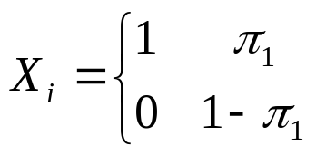
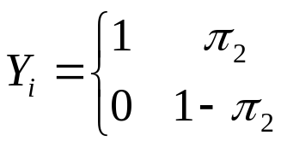
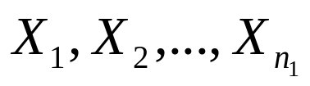
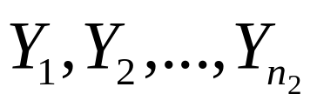
Two populations and two proportions
Population 1
Population 2
Sample 1
Sample 2

Slide 56
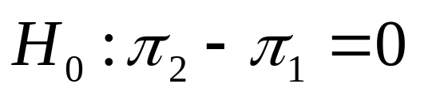
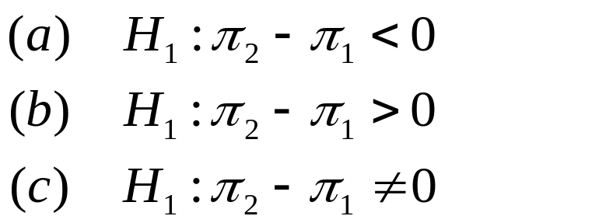
The testing problem
The null hypothesis that we want to test
versus an alternative hypothesis
One sided
Two sided

Slide 57
8.2.1: Sampling distribution of the difference of two proportions

Slide 58
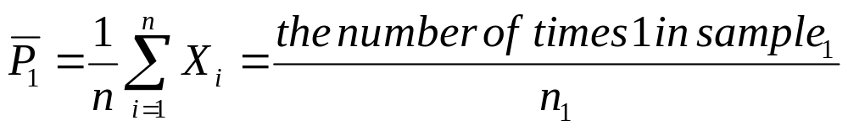
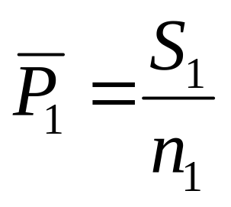
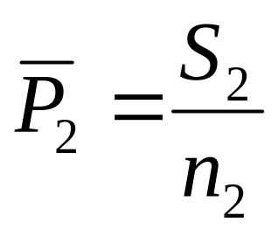
The sample proportions
Suppos S₁ the number of successes in the first sample and S₂ the number of successes in the second sample.
The proportions of the sample are then given by

Slide 59
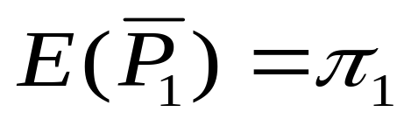
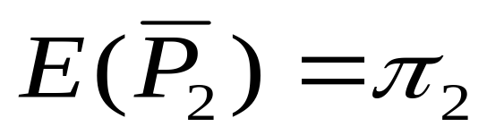
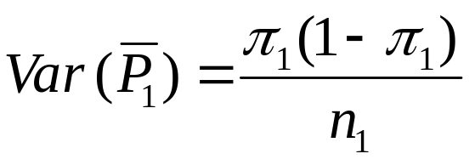
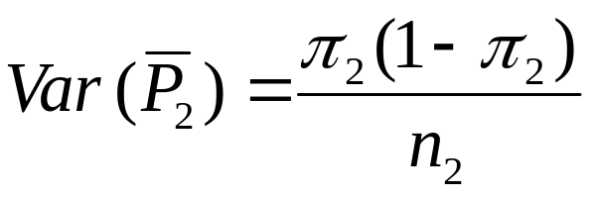
a sample from the first population
a sample from the second population

Slide 60
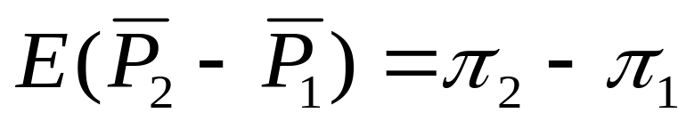

The average and the variance of the difference

Slide 61


The proportion under H₀
The null hypothesis says that π₁=π₂=π (for some unknown value π).
So H₀ is true:

Slide 62

The pooled sample proportion
Problem is that π is not known. An estimator for p is given by the pooled sample proportion

Slide 63


The test statistic
unknown parameter

Slide 64
8.2.3: Comparing two population proportions

Slide 65

The test statistic
If n₁ and n₂ are sufficiently large, then

Slide 66
Example 5:
Two-sided testing problem
A study on the effect of oral contraceptives (OC) on the occurrence of myocardial infarction (MI) in women (40-44 years) produced the following results (for an observation period of 3 years):
From 5000 OC users 13 women were with MI
10000 non - OC users 7 women were with MI
What is the statistical significance of these results?

Slide 67

solution
π₁ is the population proportion of MI in OC users
π₂ is the population proportion of MI in non-OC users.
Null hypothesis
Alternative hypothesis

Slide 68


Sample proportion
the pooled sample proportion

Slide 69


The test statistic

Slide 70


The test statistic
the value of test of statistic is:

Slide 71
The rejection region (two-tailed test)
The test statistic
-3.01< -1.96 we reject H₀ at significance level 0.05.
-3.01
-1.96
1.96
Rejection Region R.R
Acceptance region
Rejection Region R.R

Slide 72
2-sided test
The p-value of the two-sided test is given by :
So there is a very significant difference between the occurrence of MI in OC users and non-OC users (α = 0.05).

Slide 73
Comparing two population proportions using R
> library(MASS)
> prop.test(c(7,13),c(10000,5000), correct = F)
2-sample test for equality of proportions without
continuity correction
data: c(7, 13) out of c(10000, 5000)
X-squared = 9.037, df = 1, p-value = 0.002646
alternative hypothesis: two.sided
95 percent confidence interval:
-0.0034036884 -0.0003963116
sample estimates:
prop 1 prop 2
0.0007 0.0026

Slide 74

The checklist
Step | Information | example
1 | Test of Hypothesis
2 | Determine case
3 | The test statistic The distribution of the test statistic under the null hypothesis
4 | The level of significance
5 | The critical point (or points) & R.R
6 | Calculate the test statistic | -3.01
7 | Conclusion | Reject Ho
-1.96 & 1.96 N(0,1)

Slide 75
Inference for two or more groups
Chi-squared test for independence.
Analysis of I x J contingency tables.
Section 8.3

Slide 76
Analysis of IxJ contingency tables
The main goal of analysing a contingency table is to test independence between rows and columns.
In our case study, the null hypothesis is that there is no association between anaemia prevalence and socio-economic status. Therefore, the distribution of outcome categories should be independent of the explanatory variable

Slide 77

Analysis of IxJ contingency tables
2 x 2 contingency table

Slide 78

Analysis of IxJ contingency tables
2 x 2 contingency table

Slide 79

Analysis of IxJ contingency tables
4 x 2 contingency table

Slide 80

Analysis of IxJ contingency tables
4 x 3 contingency table

Slide 81




Analysis of IxJ contingency tables
Independence test in a generalised two-way contingency tables of nominal outcomes can be tested using;
;
;
If the independent assumptions holds, then the distribution of the cell counts is independent of the rows and the columns.

Slide 82



Probability under independence
For two independent events:
In a I X J table :

Slide 83




Analysis of IxJ contingency tables

Slide 84



Analysis of IxJ contingency tables
Pearson Chi-square statistics

Slide 85
Analysis of IxJ contingency tables
Investigate whether there is association between child location and child anaemia.
Areas | Anemic |  | Total
 | Yes | No
A | 101 | 99 | 200
B | 83 | 117 | 200
C | 112 | 89 | 201
D | 74 | 126 | 200
Total | 370 | 431 | 801

Slide 86


Analysis of IxJ contingency tables

Slide 87


Analysis of IxJ contingency tables

Slide 88
Chi-square test in R
areaAnemic <- table(nonMissingAnemic$Areas, nonMissingAnemic$Child_Anemic, exclude=FALSE)
nplus. <- rowSums(areaAnemic)
n.plus <- colSums(areaAnemic)
npluplus <- sum(areaAnemic)
Oij <- areaAnemic
Eij <- (nplus.%*%t(n.plus))/npluplus
tmp <- ((Oij-Eij)^2)/Eij
X2 <- sum(tmp)
df <- (nrow(areaAnemic)-1)*(ncol(areaAnemic)-1)
pvalue <- pchisq(X2, df,lower.tail = FALSE))

Slide 89
Chi-square test in R
Results
X² = 17.4
Pvalue = 0.0006
Interpretation
There is a significant association between child location and child anaemia.

Slide 90
Chi-square test in R
Definition of the variables
> Anemic<- as.factor(c(rep("Yes",101),rep("No",99),rep("Yes",83),rep("No",117)
,rep("Yes",112),rep("No",89),rep("Yes",74),rep("No",126)))
> Areas<-as.factor(c(rep("A",101),rep("A",99),rep("B",83),rep("B" ,117),rep("C",112),rep("C" ,89),rep("D",74),rep("D" ,126)))

Slide 91
Chi-square test in R
Chi-square for independence
> areaAnemic<-table(Anemic,Areas)
> areaAnemic
Areas
Anemic A B C D
No 99 117 89 126
Yes 101 83 112 74
> chiArea <- chisq.test(areaAnemic,correct = FALSE)
> chiArea
Pearson's Chi-squared test
data: areaAnemic
X-squared = 17.4074, df = 3, p-value = 0.0005827

Slide 92
Example: A 2 X 2 table
Suppose we are interested in investigating whether younger children were more prone to anaemia than the older children.
Data were collected about 779 subjects.
Variables of interest: Anaemia (Yes/No), age.
We need to create a contingency or a cross tabulation table with the outcome variable (Anaemia) on the columns and the explanatory variable (Age category of children) on the rows.

Slide 93



Example: a 2 X 2 table
Age categories | Anemic |  | Total
 | Yes | No
6-23 months | 259 | 169 | 428
24-59 months | 310 | 469 | 779

Slide 94



Risk Difference: estimation
Age categories | Anemic |  | Total
 | Yes | No
6-23 months | 259 | 169 | 428
24-59 months | 310 | 469 | 779

Slide 95


Risk Difference
Test for independence

Slide 96
Risk Difference in R
> RDanemic <- prop.test(x=ageAnemic[,2], n= rowSums(ageAnemic) , correct = FALSE)
>
> RDanemic
2-sample test for equality of proportions without continuity
correction
data: ageAnemic[, 2] out of rowSums(ageAnemic)
X-squared = 47.5894, df = 1, p-value = 5.255e-12
alternative hypothesis: two.sided
95 percent confidence interval:
-0.2648663 -0.1495219
sample estimates:
prop 1 prop 2
0.3979461 0.6051402

Slide 97
Example: a 2 X 2 table
Age categories | Anemic |  | Total
 | Yes | No
6-23 months | 259 | 169 | 428
24-59 months | 310 | 469 | 779
> Oij <- ageAnemic
> Oij
No Yes
24-59 months 469 310
6-23 months 169 259
>
> nplus. <- rowSums(ageAnemic)
> nplus.
24-59 months 6-23 months
779 428
> n.plus <- colSums(ageAnemic)
> n.plus
No Yes
638 569
> npluplus <- sum(ageAnemic)
> npluplus
[1] 1207
> Eij <- (nplus.%*%t(n.plus))/npluplus
> Eij
No Yes
[1,] 411.7664 367.2336
[2,] 226.2336 201.7664
>
> tmp <- ((Oij-Eij)^2)/Eij
> X2 <- sum(tmp)
> X2
[1] 47.58941

Slide 98
Example: a 2 X 2 table
Age categories | Anemic |  | Total
 | Yes | No
6-23 months | 259 | 169 | 428
24-59 months | 310 | 469 | 779
chi.sq <- chisq.test(ageAnemic,correct = FALSE)
> chi.sq
Pearson's Chi-squared test
data: ageAnemic
X-squared = 47.5894, df = 1, p-value = 5.255e-12

Slide 99



Example: a 2 X 2 table – OR for rhe expected table
counts
proportions
> Eij <- (nplus.%*%t(n.plus))/npluplus
> Eij
No Yes
[1,] 411.7664 367.2336
[2,] 226.2336 201.7664
>
> tmp <- ((Oij-Eij)^2)/Eij
> X2 <- sum(tmp)
> X2
[1] 47.58941
Expected value

Slide 100

Example: a 2 X 2 table – OR for the expected table
> Eij <- (nplus.%*%t(n.plus))/npluplus
> Eij
No Yes
[1,] 411.7664 367.2336
[2,] 226.2336 201.7664
>
> tmp <- ((Oij-Eij)^2)/Eij
> X2 <- sum(tmp)
> X2
[1] 47.58941
Expected value
> ORanemic <- oddsratio(x=Eij[,2], n=rowSums(Eij))
> ORanemic
Data:
Event Size
Sample 1 367 779
Sample 2 201 428
Odds ratio: 1.006002
95 % confidence intervals
LL UL
Asymptotic 7.943026e-01 1.274123e+00
Exact 1.000000e+06 1.000000e+06
Score 7.943301e-01 1.274079e+00
OR for the expected table !!
Why OR=1 ?

